Slide 1
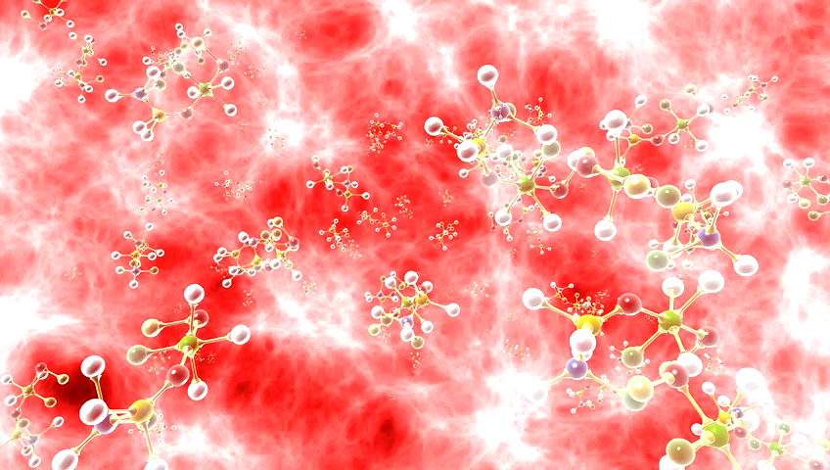
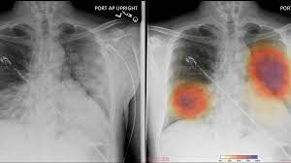
Deep Learning based detection and analysis of COVID-19 on chest X-ray images

Slide 2
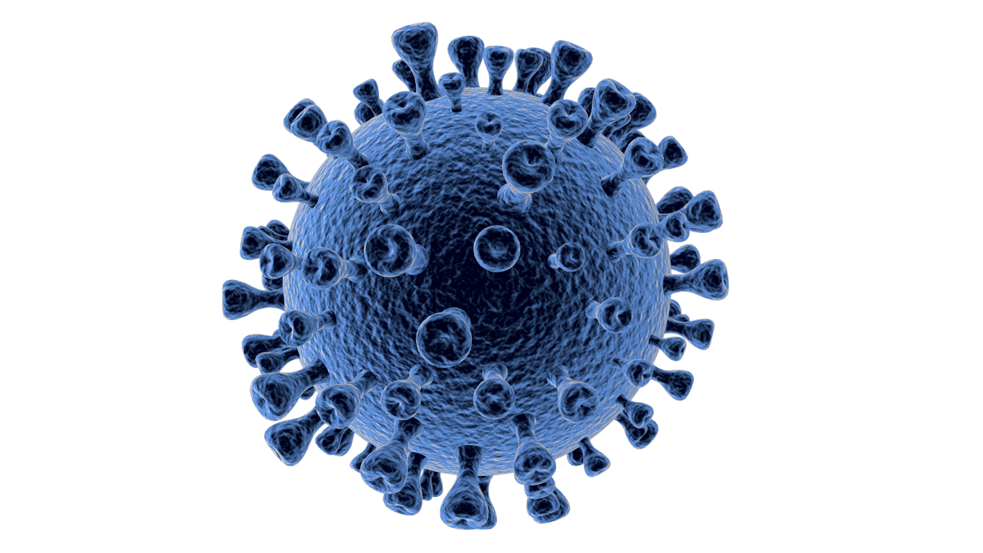
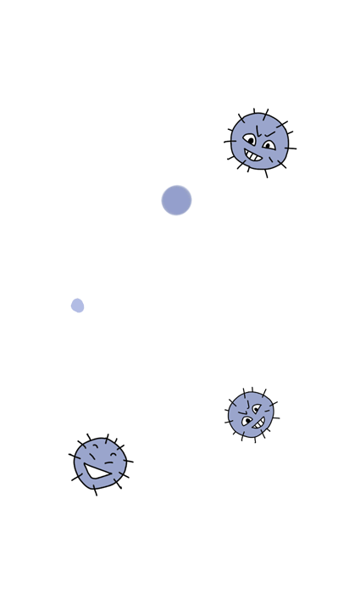
CONTENTS:
Abstract
Problem Statement
Existing System
Proposed System
Advantages
Conclusion

Slide 3
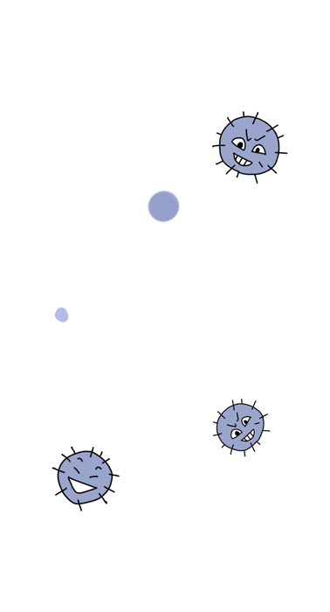

ABSTRACT
Covid-19 is a common and rapid spreading virus.
A clinical study of Covid-19 infected patients has shown that these types of patients are mostly infected from a lung infection after coming in contact with the virus.
Chest X ray (i.e.,radiography) and chest CT are a more effective imaging technique for diagnosing lung related problems.
Still, a substantial chest X-ray is a lower cost process(costs around 1000 rupees) in comparison to chest CT(approximately costs around 3000 rupees atleast).
Deep learning is the most successful technique of machine learning, which provides useful analysis to study a large amount of chest X-ray images that can critically impact on screening of Covid-19
We want to make it cost benifical.

Slide 4
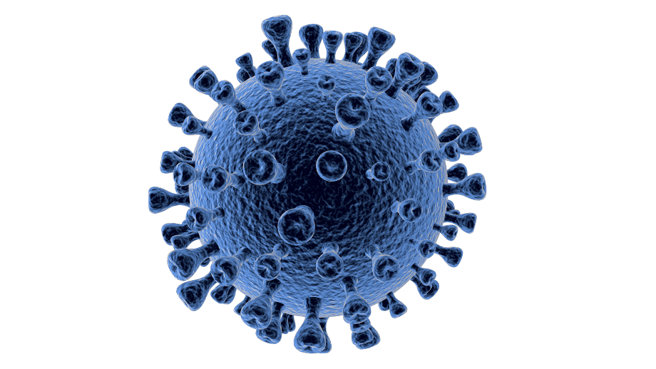

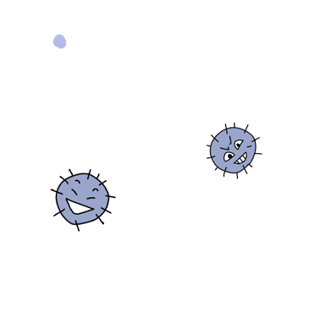
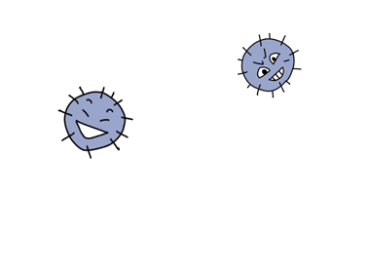
PROBLEM STATEMENT
Currently, the whole world is affected by Covid-19.
Meanwhile, detection of the virus consumes more time and cost.
Analysis of the Covid-19 and the normal patients are not accurate.
To detect the virus in shorter time and low cost and deeper analysis, we are proposing the Deep learning based detection and analysis of Covid-19 on chest X-ray images

Slide 5
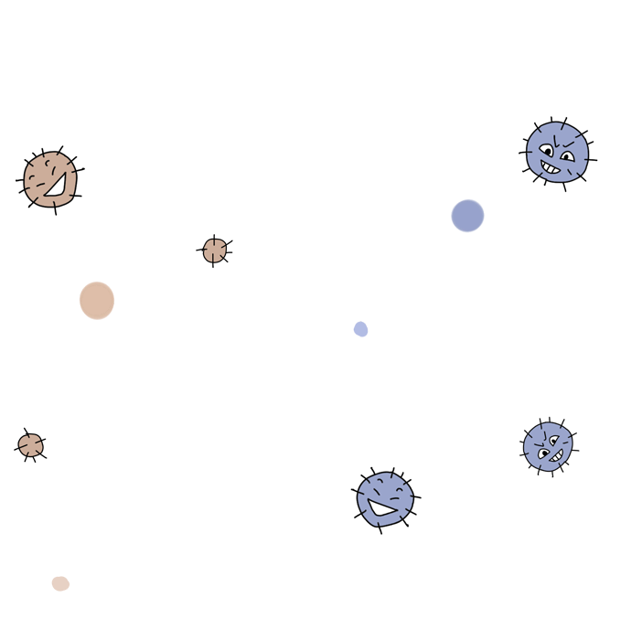

EXISTING SYSTEM
Present In the Existing system there are some methods to detect covid19.
Nucleic acid based method
Next generation sequencing
RT-PCR
Loop-mediated isothermal amplification
But these above methods are high cost and there is scarcity of equipment kit and also it takes lot of time.
z

Slide 6
Proposed System:
The proposed system is specially implemented for detecting Covid-19 cases using chest X-ray images.
This proposed system gives more accuracy compared to other models, at reduced cost and time.
We would consider the PA view of chest x-ray scans for covid-19 affected patients as well as healthy patients.
After cleaning up the images and applying data augmentation, we will use deep learning based CNN models and compare their performance and accuracy.
When you seek medical treatment, you should truthfully describe the illness and medical treatment process, especially the doctor's recent Wuhan travel and residence history, contact history of pneumonia patients or suspected patients, animal contact history, etc. Special attention should be paid to wearing surgical masks during the diagnosis and treatment to protect themselves and others.

Slide 7
2019-nCoV Prevention Manual
Advantages
It has higher accuracy.
It detects in reduced time and cost
The image augmentation technique provides sufficient instances to train the model for possible variable inputs, making the model robust.
The conventional ML algorithms can be efficiently trained using smaller datasets, fewer resources and minimal hyper-parameter tuning without compromising with the performance.

Slide 8
Conclusion:
Covid-19 pandemic is a growing drastically.
With the ever-increasing number of cases, we need to test as many people as needed, because of the airbourne nature of the disease.
At present situation, the detection of the Covid-19 disease is taking lot of time and money.
As the RT-PCR, tests are done to maximum extent, but there are cases where the kits are unavailable.
By scanning the chest X-rays using this proposed system gives more accuracy compared to other models, at low cost and time.
Comman man cannot afford the cost of existing system
So this proposed system plays a keyrole in delivering a better future and scope.

Slide 9
Team Members:
17P31A0567
17P31A0585
17P31A0594
17P31A05A1

